Slide 1
Outstanding Actions from TOPC 19
Simon Eggleston

Slide 2
Outstanding Actions
ACTION | STATUS
17) Draft requirements table for soil moisture as an example for all other terrestrial ECVs | Factsheets have been drafted for all sectors for all panels. These need to be corrected/completed at this meeting. Are these sufficient?
18) Provide short text that explains or justifies ECV requirements for each ECV
8) Prepare report for next TOPC meeting on physical consistency of ECVs, including a proposal on a way forward. | Nadine Gobron to report
20) Put Nigel Tapper in contact with Peter Thorne about the GCOS Surface Reference Network | Nigel Tapper to report
5) Consider having a teleconference between relevant TOPC members and the biogeochemistry panel of the OOPC. | Postponed - GCOS Secretariat is planning to have a cross-panel meeting next year where this can be discussed.
6) Ask OOPC for data needs from terrestrial communities in order to take future steps.
7) Identify and invite coastal expert from OOPC for next TOPC meeting in order to clarify options for collaboration.

Slide 3
Outstanding Actions
ACTION | STATUS
10) Develop proposals on how to ensure that data citations should be traceable to original versions and software. | SC taking lead on this?
11) The panel members should check for their domain if all data sets come with DOI and if citations are traceable.
19) The secretariat will establish process for contributions to GCOS (e.g. IP) can be cited similar to the process of contributing authors in the IPCC reports.
12) Nigel Tapper to lead the group that will continue to further develop a way to include adaptation requirements. | Nigel Tapper - SC taking lead on this?
21) Prepare videoconference for panel when website draft is done. | Wolfgang Wagner to report on developments
9) Review available tools for monitoring the use of datasets.
13) Establish online platform for interactive discussions on ECV requirements for community.
14) Assign responsibility for all cryospheric action items in GCOS 2016 implementation plan. Identify steward consortia for each ECV. | Michael Zemp, Hiroyuki Enomoto and Hugues Lantuit, no longer members of TOPC
15) Ensure communications between cryosphere experts on TOPC to coordinate their activities

Slide 4
ECV Stewards
Should
Maintain ECV Factsheets – update data sources
Review suggestions for new data sources
Watch over observational performance and status of Implementation Plan actions
Report to future TOPC

Slide 5
ECV Stewards
Anthropogenic Water Use | Niger Tapper
Groundwater | ?
Lakes | ?
River Discharge | ?
Soil Moisture | Wolfgang Wagner
Glaciers | Huilin Li
Ice Sheets and ice shelves | Hiroyuki Enomoto
Permafrost | Huilin Li
Snow | Hiroyuki Enomoto
Albedo | Nadine Gobron
FAPAR | Nadine Gobron
Land Surface Temperature | Darren Ghent
Land evaporation | Mathew McCabe
Leaf Area Index (LAI) | Nadine Gobron
Above-ground biomass | Sassan Saatchi
Anthropogenic GHG Fluxes | ?
Fire | Kevin Tansey
Land cover | Darren Ghent
Soil Carbon | ?

Slide 6
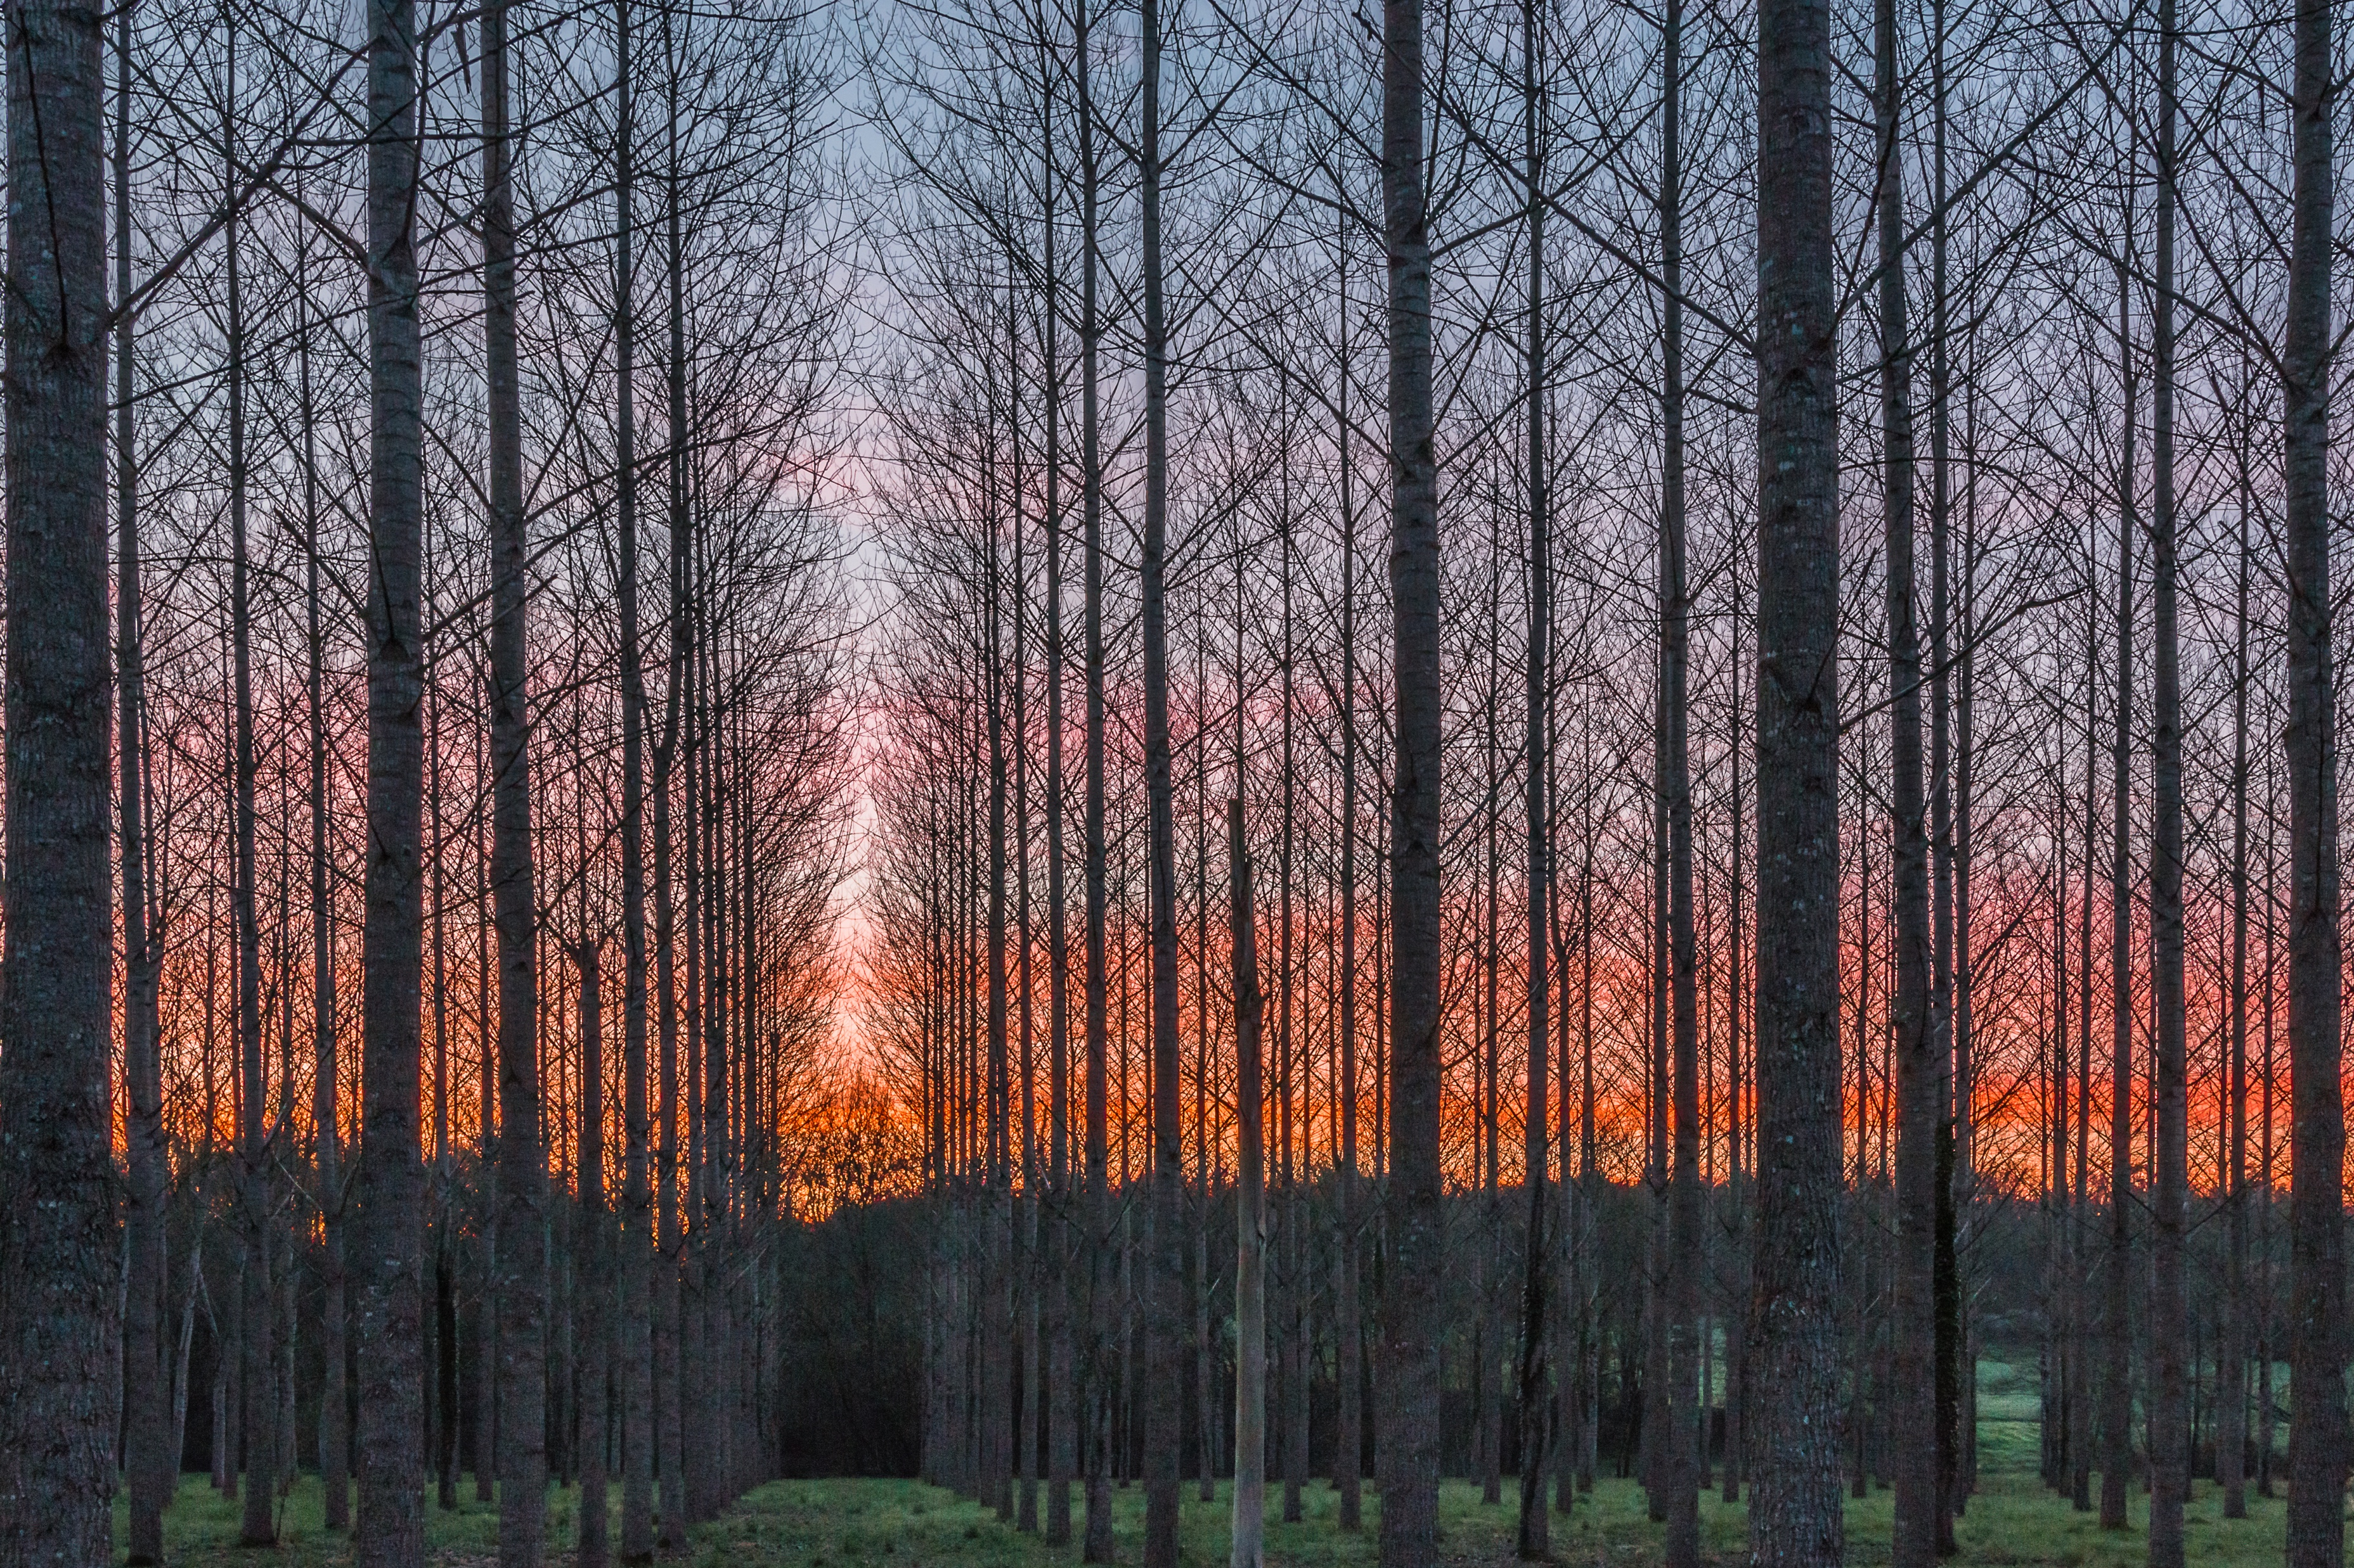
@gcos_un
gcos.wmo.int

Slide 7
Terrestrial Actions in the GCOS Implementation Plan
Simon Eggleston

Slide 8
General
# | ECV | ACTION
1 | General | Improve coordination of terrestrial observations
2 | General | Develop joint plans for coastal zones
3 | General | Terrestrial monitoring sites
4 | General | Review of monitoring guidance
5 | General | Develop metadata
6 | General | Identify capacity development needs
7 | General | Exchange of hydrological data
21 | General | Encourage and enforce research projects to make their ECV-relevant observations available through the dedicated international data centres

Slide 9
Hydrology
# | ECV | ACTION
8 | Lakes | Lakes and reservoirs: compare satellite and in situ observations
9 | Lakes | Submit historical and current monthly lake-level data
10 | Lakes | Develop additional products derived from Lake water-leaving reflectance for turbidity, chlorophyll and coloured dissolved organic matter
11 | River discharge | Confirm Global Terrestrial Network for River Discharge sites
12 | River discharge | National needs for river gauges
13 | Groundwater | Establish a full-scale Global Groundwater Monitoring Information System (GGMS)
14 | Groundwater | Operational groundwater monitoring from gravity measurements
15 | Soil moisture | Satellite soil-moisture data records
16 | Soil moisture | Multi-satellite, soil-moisture data services
17 | Soil moisture | International soil-moisture network
18 | Soil moisture | Regional high-resolution soil-moisture data record

Slide 10
Cryosphere
# | ECV | ACTION
19 | Glaciers | Maintain and extend the in situ mass balance network
20 | Glaciers | Improve the funding situation for international glacier data centres
22 | Glaciers | Global glacier inventory
23 | Glaciers | Multi-decadal glacier inventories
24 | Glaciers | Allocate additional resources to extend the geodetic dataset
25 | Glaciers | Extend the glacier-front variation dataset both in space and in time
26 | Glaciers | Glacier observing sites
27 | Glaciers | Observations of glacier velocities
28 | Snow | Snow-cover and snowfall observing sites
29 | Snow | Integrated analyses of snow
30 | Ice sheets and Ice shelves | Ice-sheet measurements
31 | Ice sheets and Ice shelves | Ice-sheet model improvement
32 | Ice sheets and Ice shelves | Continuity of laser, altimetry and gravity satellite missions
33 | Permafrost | Standards and practices for permafrost
34 | Permafrost | Mapping of seasonal soil freeze/thaw

Slide 11
LAI, FAPAR and Albedo etc.
# | ECV | ACTION
35 | LAI, FAPAR and Albedo | Ensure the consistency of the various radiant energy fluxes
36 | LAI, FAPAR and Albedo | Climate change indicators for adaptation
37 | LAI, FAPAR and Albedo | Quality of ground-based reference sites for FAPAR and LAI
38 | LAI, FAPAR and Albedo | Improve snow and ice albedo products
39 | LAI, FAPAR and Albedo | Improve in situ albedo measurements
40 | LAI, FAPAR and Albedo | Production of climate data records for LAI, FAPAR and Albedo
41 | LAI, FAPAR and Albedo | Evaluate LAI, FAPAR and Albedo
42 | Land surface temperature | Land-surface temperature: in situ protocols
43 | Land surface temperature | Production of land-surface temperature datasets
44 | Land surface temperature | Reprocessing land-surface temperature
45 | Land surface temperature | Land-surface temperature in situ network expansion
46 | Land surface temperature | Land-surface temperature radiometric calibration
72 | LAI, FAPAR and Albedo | Prepare for a latent and sensible heat flux ECV

Slide 12
Biosphere
# | ECV | ACTION
47 | Land cover | Land-cover experts
48 | Land cover | Annual land-cover products
49 | Land cover | Land-cover change
50 | Land cover | Land-cover community consensus
51 | Land cover | Deforestation
52 | Above-ground biomass | Collaboration on above ground biomass
53 | Above-ground biomass | Above-ground biomass validation strategies
54 | Above-ground biomass | Above-ground biomass validation sites
55 | Above-ground biomass | Above-ground biomass data access
56 | Above-ground biomass | Above-ground biomass: forest inventories
57 | Soil carbon | Soil carbon: carbon mapping
58 | Soil carbon | Soil-carbon change
59 | Soil carbon | Soil carbon – histosols
60 | Fire | Historic fire data
61 | Fire | Operational global burned area and fire radiative power
62 | Fire | Fire maps
63 | Fire | Fire validation
64 | Fire | Fire disturbance model development

Slide 13
Anthropogenic use of resources
# | ECV | ACTION
65 | Water use | Anthropogenic water use
66 | Water use | Pilot projects: anthropogenic water use
67 | Greenhouse gas fluxes | Improve global estimates of anthropogenic greenhouse-gas emissions
68 | Greenhouse gas fluxes | Use of satellites for Land use, land-use change and forestry emissions/removals
69 | Greenhouse gas fluxes | Research on the land sink
70 | Greenhouse gas fluxes | Use of Inverse modelling techniques to support emission inventories
71 | Greenhouse gas fluxes | Prepare for a carbon-monitoring system

Slide 14
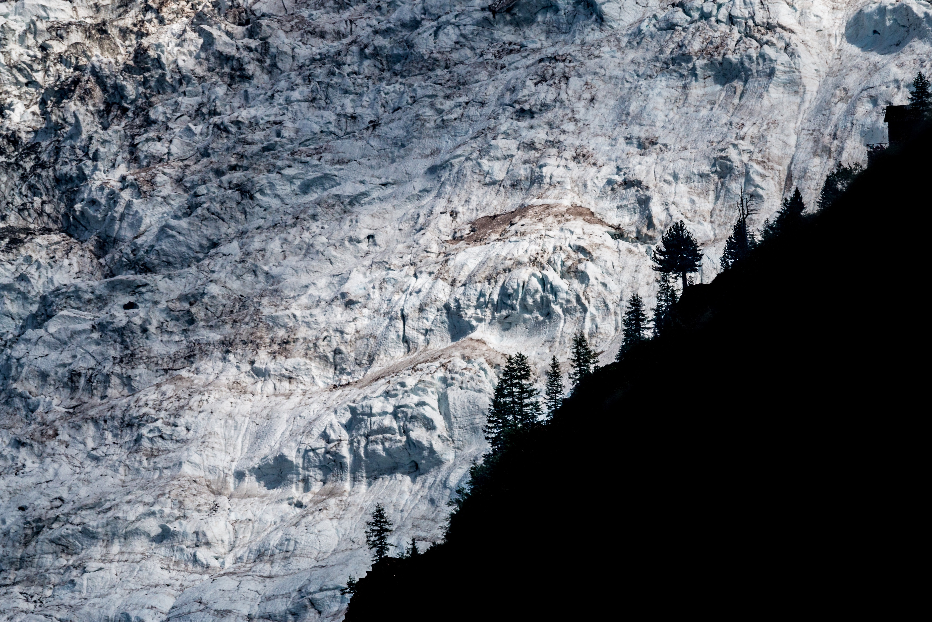
@gcos_un
gcos.wmo.int

