Slide 1
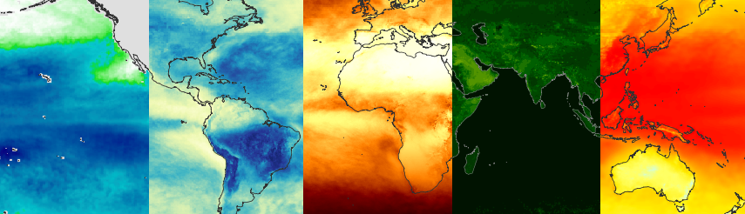
Climate Monitoring SAF: An overview
R. Hollmann and CM SAF team

Slide 2
Overview
Personal background and relation with GCOS
CM SAF and applications
Summary

Slide 3
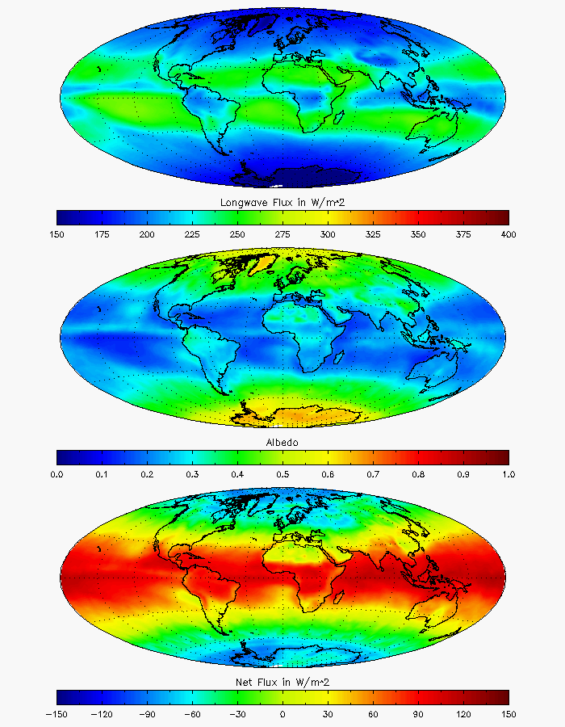
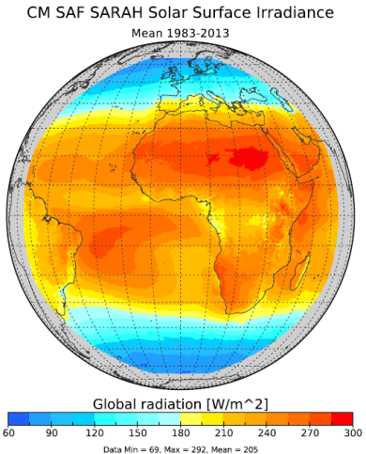
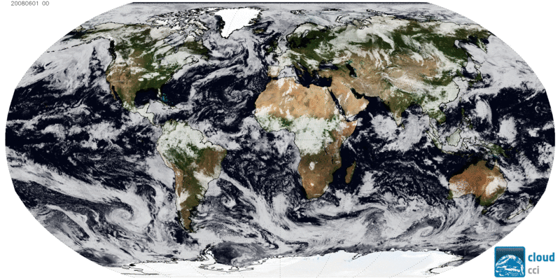
Personal background
Remote Sensing with satellites
  ERB with ScaRaB, GERB, CERES
  Moved to Surface Radiation
  Cloud properties
Now: Head of science
satellite based climate monitoring

Slide 4
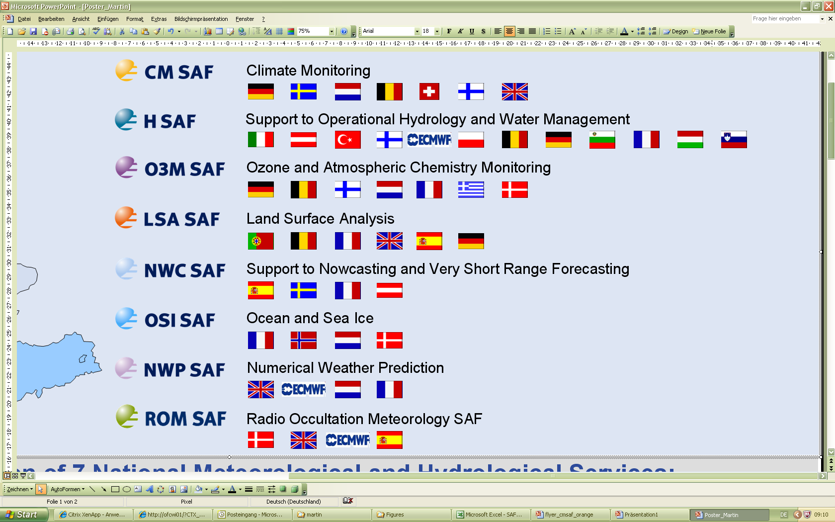


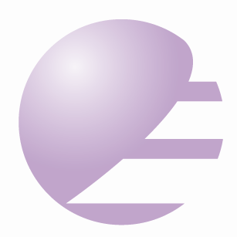



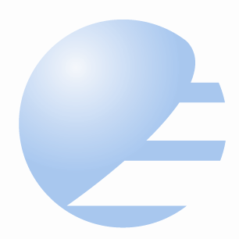

International Effort: EUMETSAT SAF network
EUMETSAT Member States
EUMETSAT Cooperating States

Slide 5

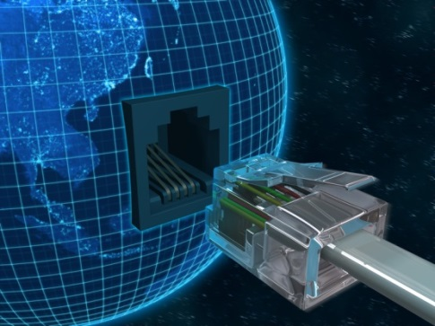
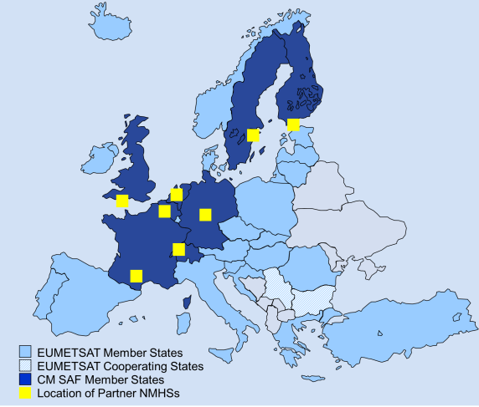




Free and easy access via
https://wui.cmsaf.eu/
The EUMETSAT Satellite Application Facility on Climate Monitoring develops, generates, archives and distributes high-quality satellite-derived products of the energy & water cycle in support to monitor, understand and adapt to climate variability and climate change.
Web User Interface allows:
Easy selection and online ordering
of Data Records (DOI-referenced)
Standing orders
Postprocessing, i.a.
  Reformating of data
  Area selection (also CORDEX areas)
  On request some data are available compliant with Ops4MIPs
Notes:
Hinweis auf neuen Partner CNRS/LEGOS für globalen Niederschlag

Slide 6
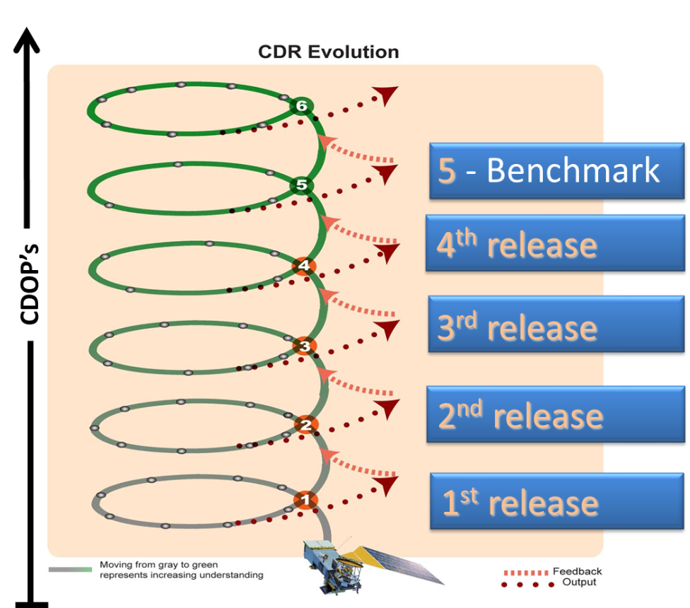

CM SAF: Long-term sustained efforts for climate
PP
1999-2004
IOP
2004-2007
CDOP-4
2022-2027
CDOP-5
2027-2032
CDOP-1
2007-2012
CDOP-2
2012-2017
CDOP-3
2017-2022
PP (Project Phase), IOP (Initial Operations Phase), CDOP (Continuous Development and Operations Phase)
Main topics addressed from 2012 – 2017
  Cyclic update of CDR‘s of variables related to GCOS and the E & W cycle
  Comprehensive user support and training
  Continued data provision
  Co-leading GDAP Assessment
In an agile framework using opportunities and chances
www.cmsaf.eu
www.cmsaf.eu/tools
Notes:
Nachhaltigkeit, Perspektive, CM SAF braucht wissenschaftlichen Input; mehrmals machen generiert Verbesserungen, Folie anhand CLARA-A2 kommt später

Slide 7
CM SAF: Long-term sustained effort for climate
PP
1999-2004
IOP
2004-2007
CDOP-3
2017-2022
CDOP-4
2022-2027
CDOP-5
2027-2032
CDOP-1
2007-2012
CDOP-2
2012-2017
PP (Project Phase), IOP (Initial Operations Phase), CDOP (Continuous Development and Operations Phase)
Objectives for 2017 – 2022
  Continuation with the overall successful data records
  Extended CDR portfolio:
    Global Precipitation CDR
    Regional Evapotranspiration CDR
  Support to SCOPE-CM & GSICS
In an agile framework using opportunities and chances
Notes:
Nachhaltigkeit, Perspektive, CM SAF braucht wissenschaftlichen Input

Slide 8
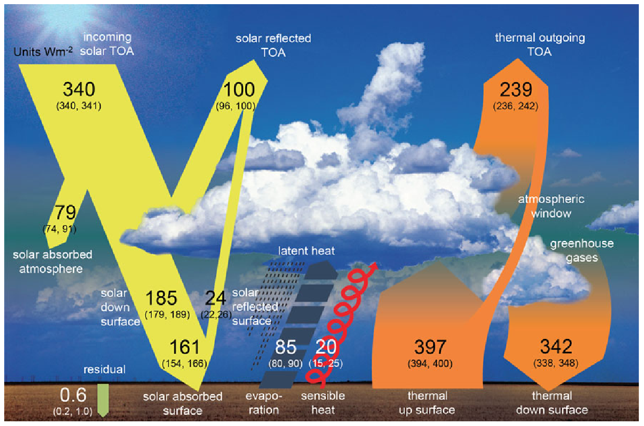
CM SAF Products and achievements
CM SAF CDRs
available
CLAAS-2
CLARA-A2
FCDR MW
HOAPS
SARAH-2
COMET
SUMET
TOA Rad
Aerosols
UTH
Source: Wild et al., 2013
Notes:
Nur als Übersicht; kurz Datensatz erwähnen und auf die abgedeckten Variablen anhand des Bildes hinweisen. In Klammern kommt noch. Bitte auf entsprechende Poster und Konferenzbeiträge hinweisen.

Slide 9



20 % of Climate Data Records from CM SAF
CEOS & CGMS WG Climate ECV Inventory
Essential Climate Variables

Slide 10
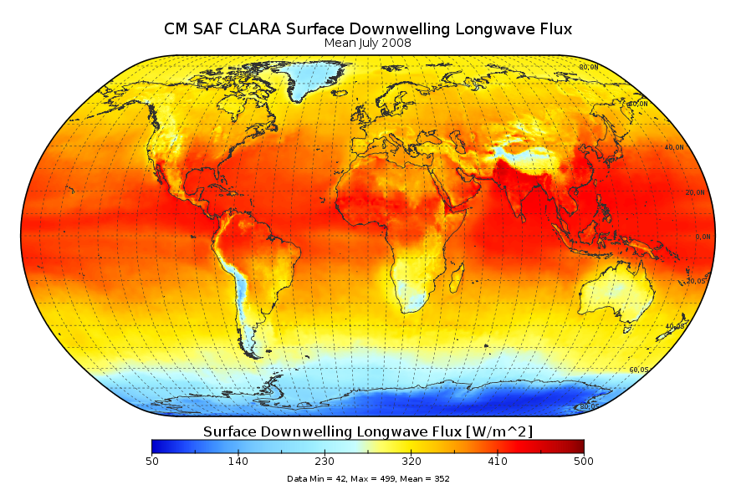
CLARA-A1 / CLARA A2 released in early 2017
Variables
  Cloud properties
  Surface albedo
  Surface radiation
Grid
  spatial: 0.25° × 0.25°
  temporal: daily-, Pentad-, Monthly means
Coverage
  spatial: Global
  Temporal: 1982 to 2009 (2015)
Satellites
  NOAA, Metop (AVHRR)
DOI:10.5676/EUM_SAF_CM/CLARA_AVHRR/V002
Notes:
Data freely available, without restrictions

Slide 11
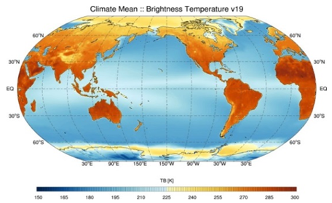
FCDR SSM/I, SSMIS, SMMR released in 2017
Variable
  Brightness temperature
Grid
  spatial: Native SSM/I (SSMIS)
  temporal: Native SSM/I (SSMIS)
Coverage
  spatial: Global
  temporal: 1987 to 2008 (2014)
Satellites
  DMSP (SSM/I), DMSP (SSMIS)
DOI:10.5676/EUM_SAF_CM/FCDR_MWI/V002
Notes:
Alternativfolie

Slide 12
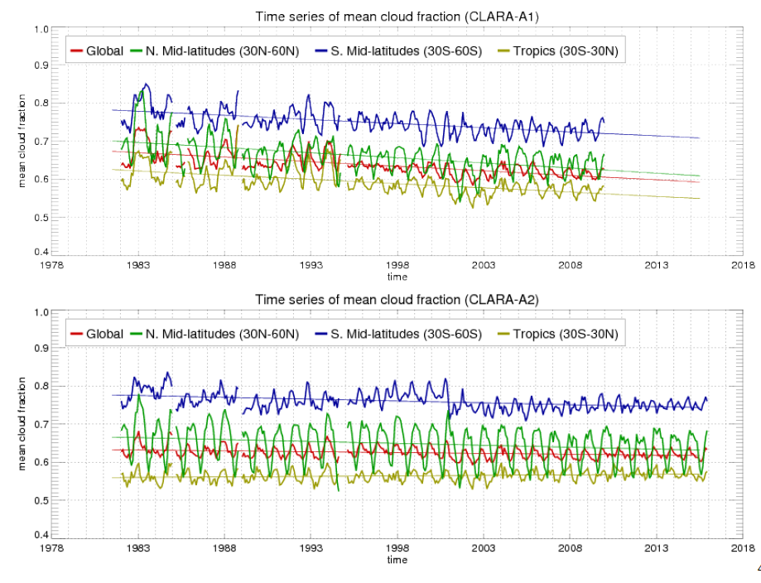
CLARA-A1 to CLARA-A2
Global mean cloud fraction
CLARA-A1
CLARA-A2
… due to improved algorithms and Level 1 data screening
Notes:
Einmal reicht nicht, hier sieht man klare Verbesserungen auch in der Stabilität; für CDOP-3 sind mit besseren FCDR’s weitere Verbsserungen zu erwarten.

Slide 13
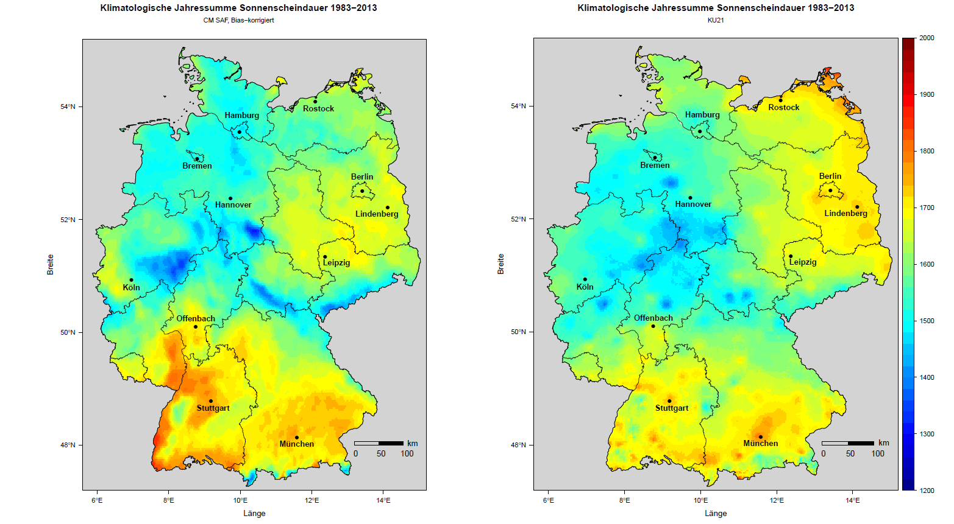
Application example
Sunshine duration: example for integrated Multi Source Climate Monitoring
Integrated
In-situ
Sat
Notes:
Oder auch regionale Nutzung zur Integration mit Bodenmessnetzen. Die roten Kreise zeigen Merkwürdigkeiten in der Interpolation der Bodenwerte, die im Satelliten nicht sichtbar sind und dann durch das Merging reduziert werden bzw. verschwinden.

Slide 14
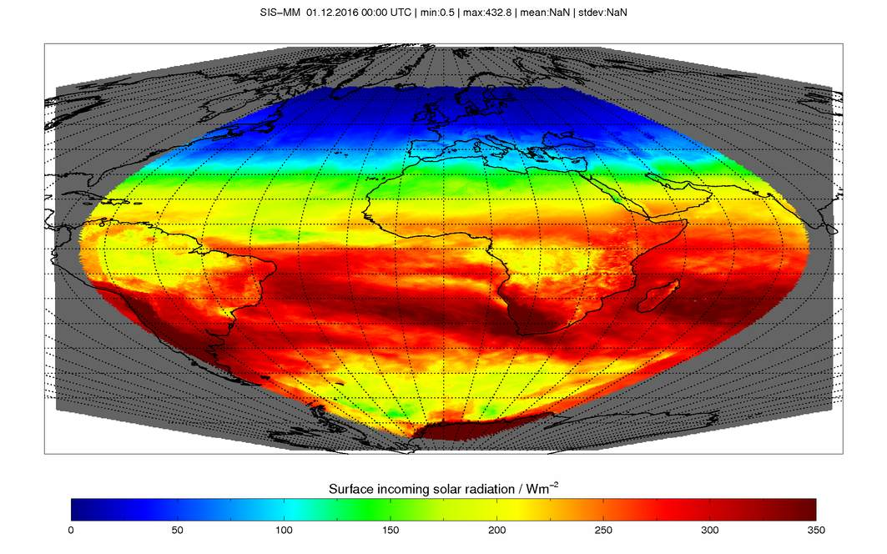
Support climate services
ICDR processing
Regular provision of selected ICDR in combination with available TCDR
Updated information of corresponding TCDR
Available in shorter time latency
Based on operational satellites with their nominal calibration and NWP data
CM SAF next steps
Gap filling between the most recent TCDR and the related successor release with ICDR
TCDR-ICDR-concept supports in particular climate services
Processing at EUMETSAT sec., support of processing, monitoring and quality assurance at CM SAF
CM SAF ICDR products
ICDR SEVIRI (backlog CDOP-2)
  CFC and CTO based on CLAAS-2
  SIS and SDI based on SARAH-2
ICDR AVHRR GAC
  CFC, CTO, CPH, LWP, IWP, SIS, and SAL based on CLARA-A2.
Spatial resolution: (0.05°)² on reg. lat/lon grid,
Products available as gridded daily and monthly means in netCDF
Availability: 5 days after observation
SIS based on SEVIRI December 2016
Notes:
Support to climate Services durch Umstellung auf ICDR Produktion für einige Variablen; ggf. weglassen

Slide 15
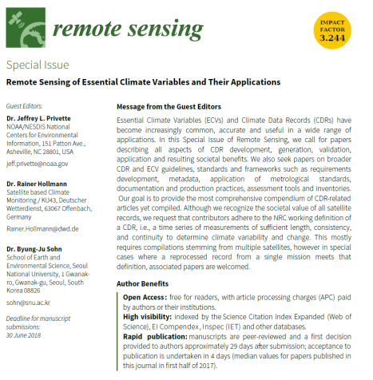

Conclusion CM SAF
Products and Services connected with CDRs of the global Energy budget and water cycle
CDR generation in an sustained operational environment
Quality control and monitoring and reviews before publishing data
Extensive services, training and support to User
Free and easy direct data access
Special Issue for CDR in remotes sensing
Contact data:
www.cmsaf.eu
Contact.cmsaf@dwd.de

