Slide 1


CEOS/CGMS JWGC and status of actions to the IP
Joint CEOS CGMS Working Group on Climate
Agenda Item 4.2
23rd GCOS AOPC 2018
Darmstadt, Germany
6-9 March 2018

Slide 2
Content
Mandate and role of the joint CEOS/CGMS WG Climate
GCOS IP Space Agency Response
Essential Climate Variables (ECVs) Data Record Inventory
Gap Analysis
Perspective for the next two years

Slide 3
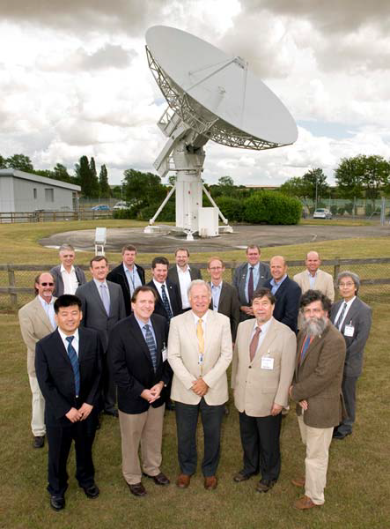
Short History
CEOS Working Group on Climate endorsed at CEOS Plenary in 2010;
The joint development of the high-level architecture for climate monitoring from space led to the formation of the Joint CEOS/CGMS WGClimate endorsed by CEOS and CGMS Plenaries in 2013:
Major Task is: Coordinate and encourage collaborative activities between the world’s major space agencies in the area of climate monitoring.
JWGClimate
Chair: Jörg Schulz (EUMETSAT)
Vice Chair: John Dwyer (USGS)

Slide 4
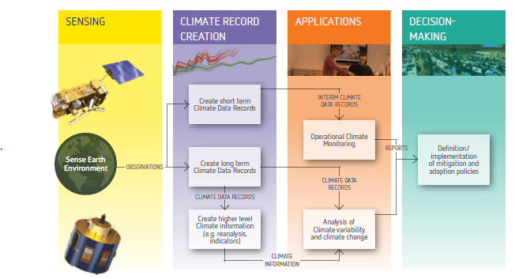


The Architecture for Climate Monitoring from Space
Implementation is the major goal of the
Joint CEOS – CGMS Working Group on Climate (JWG Climate)

Slide 5






WGClimate Reference Framework
Enable
Measurements
ECVs/CDRs
Feeds
IPCC Assessment
Science and Services
Grand Science Challenges and Climate Service Needs
Reports
Consolidated
Requirements
Based on applications?
UNFCCC
Coordinated Response on IP
JWG Climate
Systematic climate observations
Notes:
The Requirements and Actions from the Global Climate Observing System (GCOS) provide a excellent “template” for joint efforts
The GCOS process of requirements-Actions-status report is effective for programme implementation
2/3 of GCOS defined ECV can be produced through space-based observations
Research: “strengthening scientific knowledge”
Research feeds IPCC assessment reports
Climate Research has requirements of its own
WCRP and its observation panels play a key role
A robust science base is needed for all GFCS pillars
This is true for “Observations and monitoring”
Science of observation and extraction of Climate Data Records shall not be underestimated

Slide 6


Courtesy: Carolin Richter, GCOS
International framework for climate observations/records
gcos.wmo.int
@gcos_un
2016
GCOS Implementation Plan
Notes:
Slide from Caroline

Slide 7
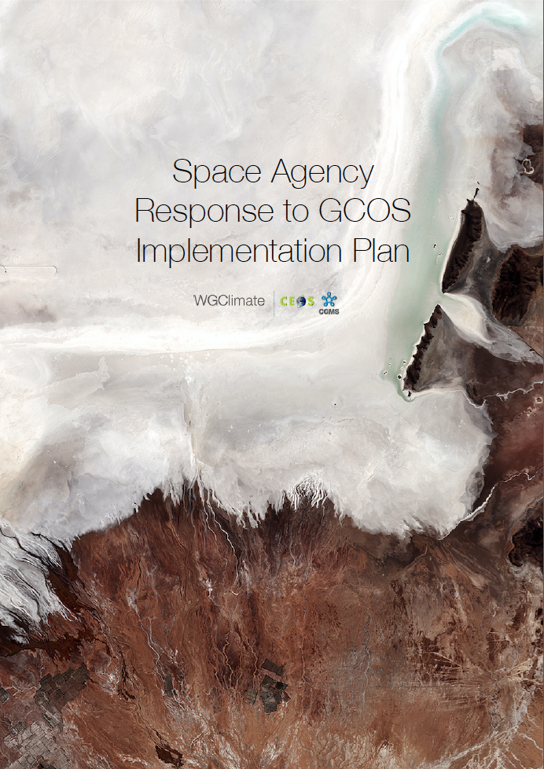
Response of Space Agencies: CGMS and CEOS
http://ceos.org/document_management/Meetings/Plenary/31/Presentations/2.1-Space%20Agency%20Response%20to%20GCOS%20IP%20v2.0.pdf

Slide 8
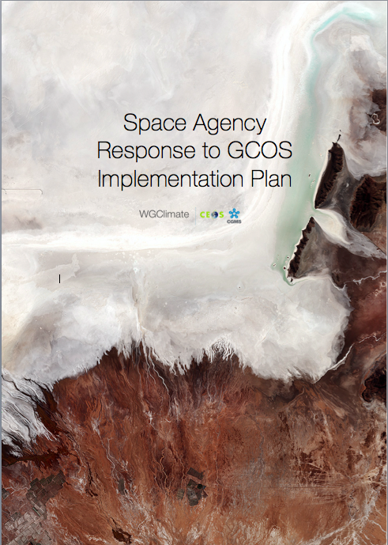
Space Agency Response to the GCOS IP
Addresses GCOS Actions with space relevance;
In total 11 (32) general, 19 (40) atmospheric, 17 (57) oceanic and 48 (72) terrestrial actions;
Structure of response is similar to the plan itself;
A technical supplement has been drafted including more detailed responses to the GCOS IP.

Slide 9
GCOS Actions

Slide 10
ECV Inventory and Gap Analysis
Action Plan & Creation of conditions to deliver CDRs
ECV Inventory
Gap Analysis & Recommendations
ECV Inventory 2.0 published;
Fully describes current and planned implementation arrangements (ECV-by-ECV) within the Architecture;
More than 4 times more data records 913 versus ~210 compared to first version 2015;
Content for the first time fully verified;
Gap analysis capacity demonstrated:
  All ECV Products without CDRs identified
  Compliance of CDRs to GCOS requirements analysed
  Capability to analyse missing measurements established (Inventory/MIM/OSCAR harmonisation realised);
Financial support of the EC for the Inventory gratefully acknowledged.
✓
✓
http://climatemonitoring.info/ecvinventory
http://climatemonitoring.info/ecvinventory
http://climatemonitoring.info/ecvinventory

Slide 11
Inventory of Climate Records of ECVs observable from space
  Existing & planned records
  Entries from 11 space agencies
913 entries
    496 existing records
    417 planned records
  26% from EUMETSAT and its SAFs
  (90% from Climate Monitoring SAF)
  30 ECVs covered, out of 37 possible
http://climatemonitoring.info/ecvinventory

Slide 12
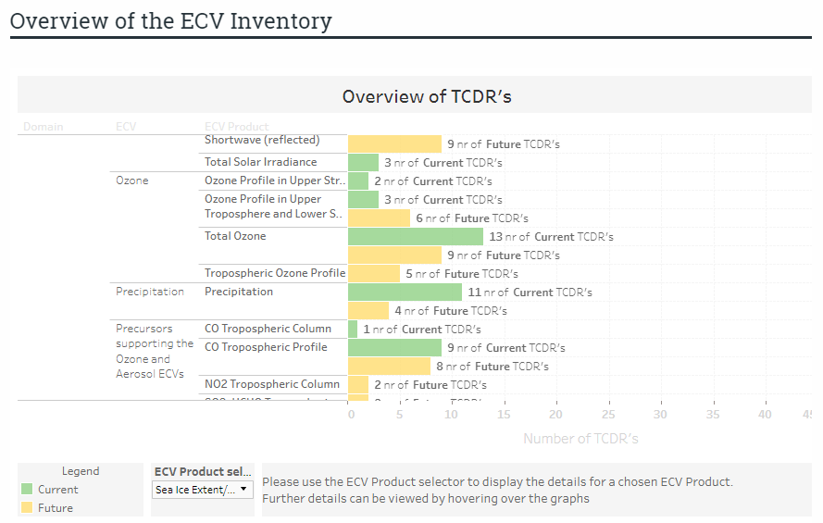
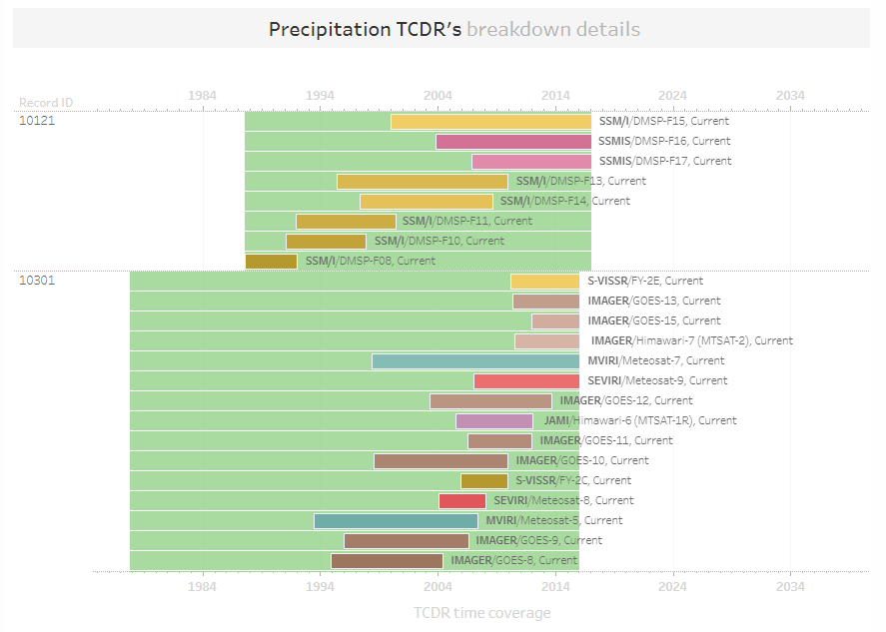
ECV Inventory provides detailed view for each data record

Slide 13
Example: Ocean ECV Products
In total the Inventory covers 27/29 (GCOS-154, 2011) and 30/35 (GCOS-200, 2016) ECVs.

Slide 14

Potential to identify missed opportunities and missions
Total gap on sea surface salinity;
Is this due to incompleteness of the Inventory?
    No “known-unknowns” at time of snapshot (know now that delivery of Sea-surface Salinity CDRs is planned under ESA CCI+);
Is this because existing data sets are not considered to be CDRs?
  Yes, time series are short and intercomparison of various satellite SSS products revealed discrepancies that prompt for further understanding of retrieval errors;
Is this because there was no mission in the past or is in the future?
  No for the past, yes for the future. No agency has a planned mission beyond SMAP and SMOS.

Slide 15
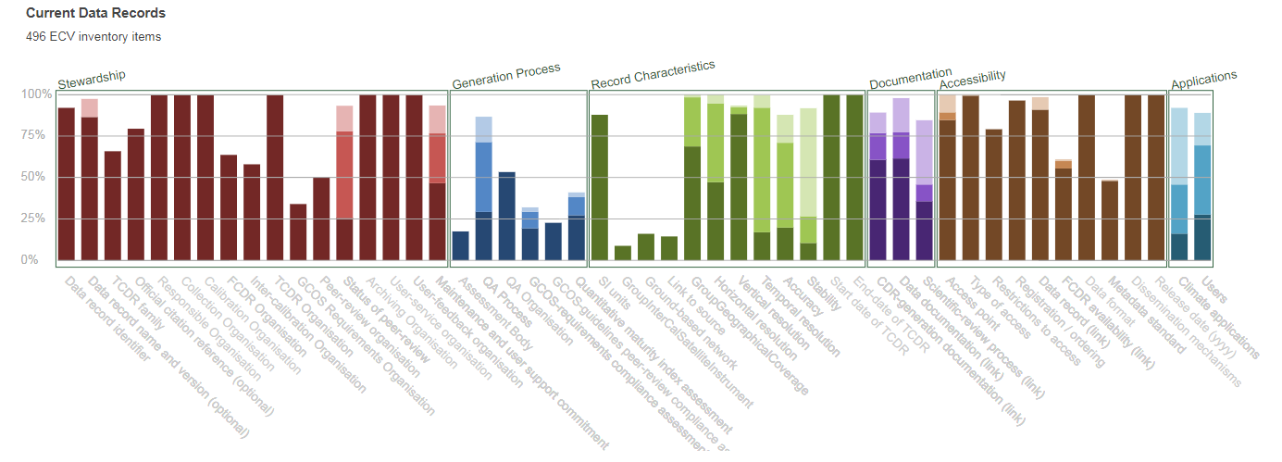
Addressing shortfalls wrt. GCOS
This analysis can be done down to the single data record.

Slide 16
Lessons learnt
The EC Funding of the inventory activities made a big difference;
Engagement with agency focal points and data set experts (>100) was key to success;
Verification process absolute critical to ensure that the inventory is a reliable source of information (for both users and the gap analysis process);
Population and verification was a huge effort - need to keep the community involvement in the future and avoid drastic changes;
Commitment level for future component of the inventory needs to be reconsidered to get a more complete picture from agencies;
Global data record development is more dynamic than we thought. Biennial update of inventory should be replaced by incremental (annual) updates;
Volume of data records does not allow full analysis of Inventory every year => need to carefully track changes during inventory update process and perform limited gap analysis in affected areas;
General low use of FCDRs to derive ECV climate data records implies extra Inventory for the base data records.

Slide 17
Perspectives for the next two years
Major Objectives:
  Complete Cycle#2 activities by SIT-33 (finalisation of Gap Analysis);
  Change reference for Inventory and Gap Analysis to the 2016 GCOS-IP (and update the inventory as appropriate);
  Promote case studies and workshops supporting the Architecture and its Inventory;
Changes:
  The Inventory-gap analysis-action plan process shall move to a more incremental update with annual reporting and endorsement (potentially synchronised with UNFCCC/SBSTA reporting);
  Gap analysis addressing Inventory updates and high priority areas, e.g., carbon cycle;
Deliverables:
  First gap analysis report and action plan for endorsement at SIT-33 and CGMS Plenary;
  Update of Inventory baseline to GCOS IP 2016 by 31 Dec 2018;
  Second gap analysis and action plan for endorsement by 2019 CEOS and CGMS Plenaries;
  Continued reporting to UNFCCC SBSTA.

Slide 18
Summary
Joint CEOS/CGMS WGClimate is the focal of point of space agencies to address GCOS requirements;
The ECV Inventory provides a structured, comprehensive and accessible view as to what Climate Data Records are currently available from satellite missions of CEOS and CGMS members or their combination;
ECV Inventory will see additions in terms of an FCDR and ICDR Inventory in 2019;
The Inventory will be annually updated inclusive of a delta gap analysis monitoring progress and addressing specific themes;
This forms the major resource to:
  Create conditions for delivering further Climate Data Records, including multi-mission Climate Date Records, through best use of available data to fulfil GCOS requirements (e.g. by identifying and targetting cross-calibration or re-processing gaps/shortfalls);
  Optimise the planning of future satellite measurements and constellations to expand existing and planned Climate Data Records.
Notes:
It is the major resource to:
Create conditions for delivering further Climate Data Records, including multi-mission Climate Date Records, through best use of available data to fulfil GCOS requirements (e.g. by identifying and targetting cross-calibration or re-processing gaps/shortfalls);
Optimise the planning of future satellite missions and constellations to expand existing and planned Climate Data Records, both in terms of coverage and record length, and to address possible gaps with respect to GCOS requirements.

