Slide 1
Group work:
Requirements table- Rational/Context
Product definitions
Data sources
ECV factsheets
ECV Stewards
GCOS Secretariat, WMO
Valentin Aich

Slide 2
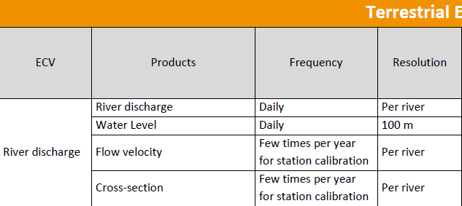
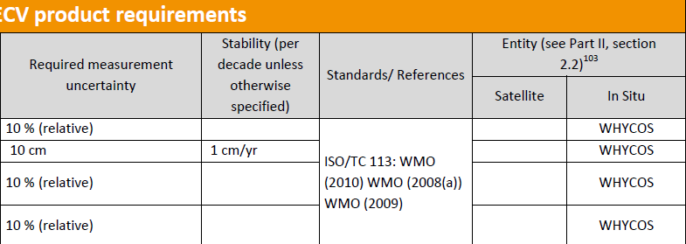
Review requirements table

Slide 3
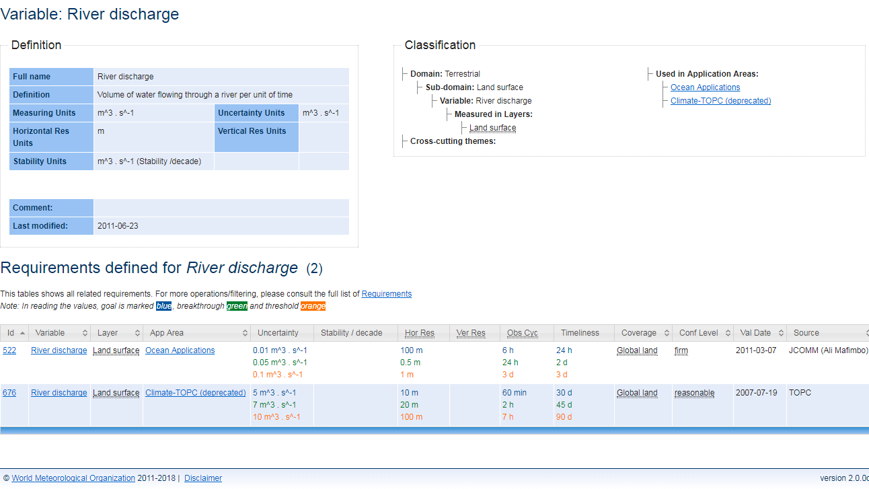
OSCAR requirements table

Slide 4
OSCAR requirements table

Slide 5
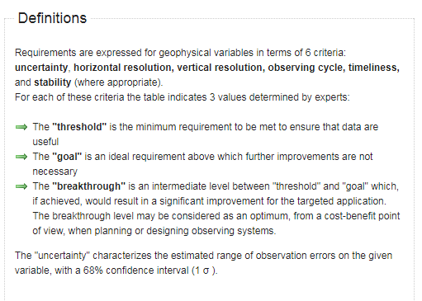
OSCAR uncertainty

Slide 6
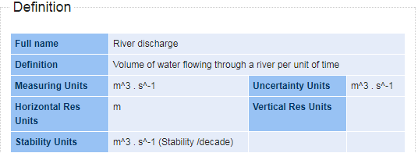
OSCAR definitions
Part of the fact sheets
If definition in OSCAR exists, are we happy with it?

Slide 7
Data sources: Steps taken
Draft list based on data sets listed in the Global Observing Systems Information Center (GOSIC)
Agree on criteria
Sent to GCOS ECV-Stewards of the three GCOS scientific panels for review
Publish/share list on website and update/maintain list

Slide 8
ECV data sources
“The vision of GCOS is for all users to have access to the climate observations, data records and information they need to address pressing climate-related concerns.[…]”
Request from different sides
GEO establishing ECV data interface
WMO-context: 1. WMO Workshop on Information Management October 2017

Slide 9
Criteria
Global in coverage
Free and open access
Quality controlled with documentation
Metadata available
Considered by the appropriate GCOS Science Panel Experts

Slide 10
Data sources
List published as living document
ECV Steward to judge suggestions for additional sources
“The list does not claim to be complete. It should provide main data sources, which offer global data for the related ECV product”

Slide 11
Factsheets
GCOS Steering Committee Meeting 2017Report:
“It was decided to produce a fact sheet for each ECV. The fact sheet will be a single page including a definition, a description, a picture, the requirements with an explanatory text. Existing fact sheets for Essential Ocean Variables (EOVs) might serve as examples or templates for other variables.”

Slide 12
Example Glacier factsheet

Slide 13
Draft facts sheets
Include basic facts about ECV
Short text why ECV is “Essential” for climate
Definitions
Requirements
Data sources
Figure of illustrative trend of ECV

Slide 14
Tasks
Include basic facts about ECV
Short text why ECV is “Essential” for climate-> Review
Definitions -> Agree
Requirements
Data sources-> Check
Figure of illustrative trend of ECV- Suggest

Slide 15
ECV Stewardships for terrestrial ECVs
ECV | Steward
Anthropogenic Water Use | Nigel Tapper
Groundwater | ?
Lakes | ?
River Discharge | ?
Soil Moisture | Wolfgang Wagner
Glaciers | Huilin Li
Ice Sheets and ice shelves | Hiroyuki Enomoto
Permafrost | Huilin Li
Snow | Hiroyuki Enomoto
Albedo | Nadine Gobron
FAPAR | Nadine Gobron
Land surface temperature | Darren Ghent
Evaporation from land | Mathew McCabe
LAI | Nadine Gobron
Above-ground biomass | Sassan Saatchi
Anthropogenic GHG Fluxes | ?
Fire | Kevin Tansey
Land cover | Darren Ghent
Soil Carbon | ?

