Slide 1


Task Teams on
Lightning, Radar and the
GCOS Reference Upper Air Network
21st March 2018
GCOS Secretariat, WMO
Valentin Aich

Slide 2
Lightning: new ECV
Measurements of lightning, both in situ and from space increased
Estimations of annual casualties range from 6000 to 24,000 casualties and a ten-fold number is injured
Substantial loss and damage (electrical infrastructure, wildfires, etc., estimates for US > 6 billion USD/a)
Lightning proxy for strong convection and severe storms
Global warming-> more humidity and convection-> more storms and lightning, but not proven
Lightning potentially positive feedback for climate change: NO_{X} produced by lightning -> precursors for O₃ , strong GHG

Slide 3
Lightning
IP Action A29:
Action | To define the requirement for lightning measurements, including data exchange, for climate monitoring and to encourage space agencies and operators of ground-based systems to provide global coverage and reprocessing of existing datasets
Benefit | Ability to monitor trends in severe storms
Who | GCOS AOPC and space agencies
Time frame | Requirements to be defined by 2017
Performance indicator | Update to Annex A for lightning and commitments by space agencies to include lightning imagers on all geostationary platforms. Reprocessed satellite datasets of lightning produced.
Annual cost | US$ 10–30 million
-> AOPC 2017 charged GCOS secretariat to establish task team on lightning for climate applications

Slide 4
Lightning Task Team Members
Robert Holzworth (chair), University of Washington, Seattle USA
Yuri Kuleshov, RMIT University Melbourne, Australia
Steven Goodman, NOAA (retired, former GOES-R Chief Scientist),
Huntsville, Alabama, USA
Earle Williams, MIT, Cambridge, Massachusetts, USA
Colin Price, Tel Aviv University, Tel Aviv, Israel

Slide 5
What happened so far
Constituted and First Telecon: Oct 26, 2017
First Face-to-face meeting Feb 5-7, 2018 (action items assigned)
Submit Announcement to EOS seeking community input (Feb 2018)
Interim report AOPC March 2018

Slide 6
Next steps
Initiative to extend historical trends with thunder day data
Potential collaboration with GRUAN to measure the global circuit and hence the global lightning activity
Survey for existing data
Draft White paper by August 2018
Final report Sept/Oct 2018

Slide 7
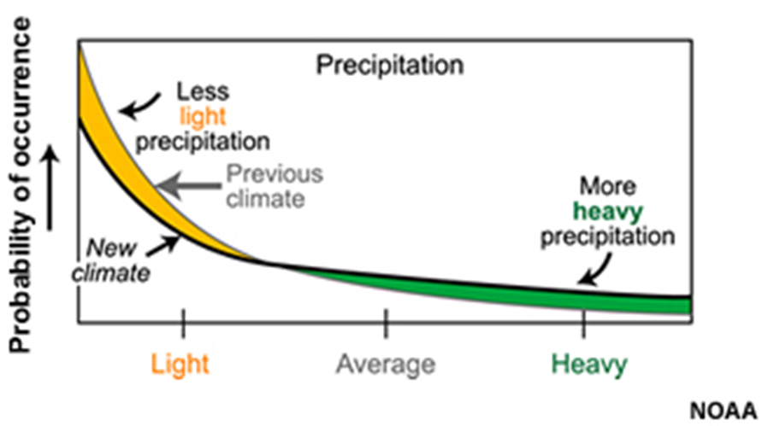
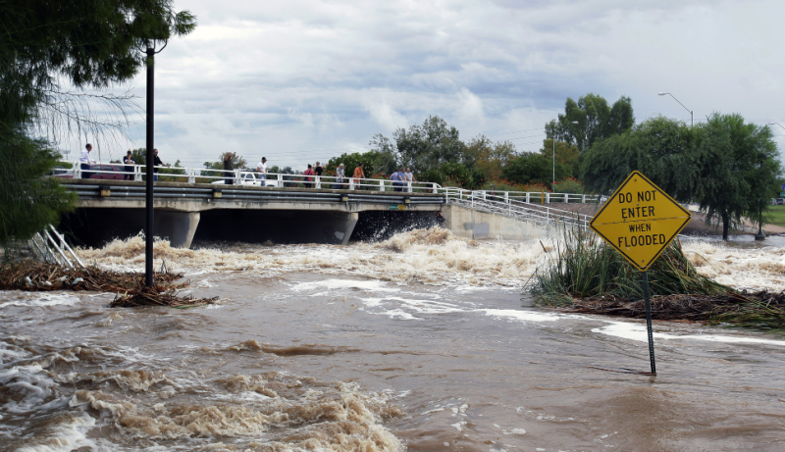
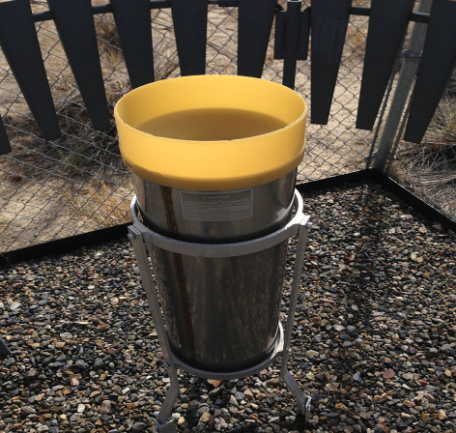
Radar for Climate
Extreme precipitation is projected to increase under climate change
Extreme precipitation is highly relevant not only for climate science (WCRP Grand Challenge) but particularly for adaptation
Currently the Essential Climate Variable (ECV) precipitation is mainly monitored with gauges or tipping-buckets
→ INSUFFICIENT TO MONITOR EXTREME EVENTS

Slide 8
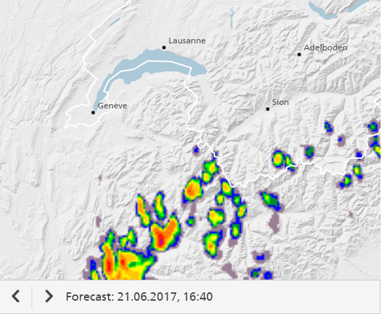

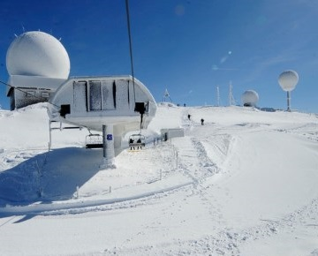
Radar for Climate
Radar is already used operationally for weather forecasting
Swiss radar station “La Dôle”, covering the Geneva region
With its high spatial and temporal resolution, radar can fill an important gap of climate observations!
→ BUT: No global coverage, No uniform method, No data standards, No continuity of observations, Partly no archiving, …

Slide 9
Radar for Climate
The 2015 GCOS status report identified the gap
The 2016 GCOS Implementation Plan calls for action
AOPC-22 2017 decides to built a task team on climate radar
ToR established; experts identified and invited
→ Aligned with the remote sensing task team of the Commission for Climatology and
coordinated by the GCOS secretariat, the Task Team on Climate Radar developed the framework and regulations for climate radar observations

Slide 10
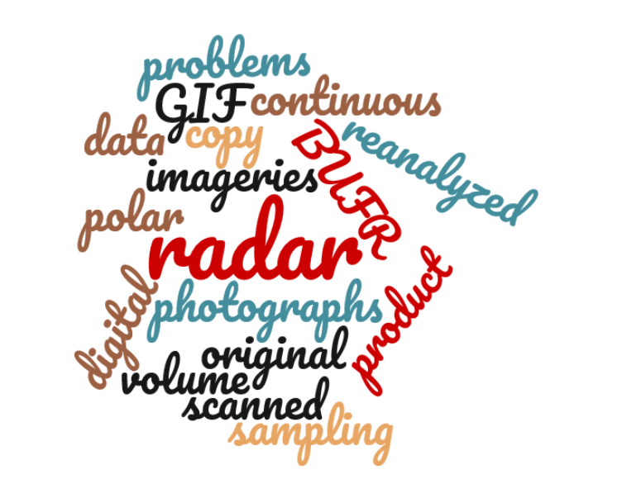
Summary and next steps
The task team is working of 4 other deliverables:
  Inventory of existing archives
  Guidance how to facilitate user access and preservation of data
  Recommendation how to handle historical data
  A manuscript for BAMS and or WMO Bulletin to raise awareness
Words from the comments of owners of log time series

Slide 11
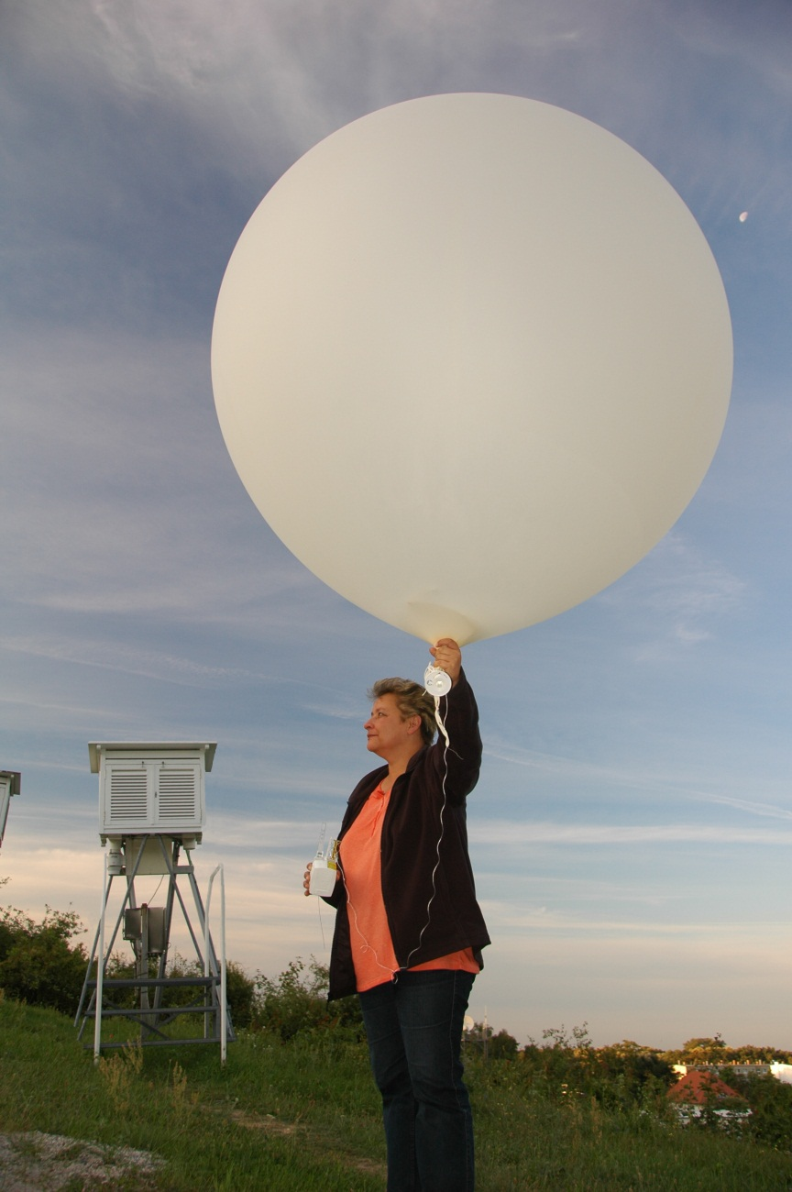
GCOS Reference Upper Air Network
(GRUAN)
activities
Ruud Dirksen
GRUAN Lead Centre
DWD Meteorological Observatory Lindenberg
Germany

Slide 12
What is GRUAN?
The GCOS Reference Upper Air Network (GRUAN):
Started in 2008
GRUAN is response to the need of WMO and the Global Climate Observing System (GCOS) for the highest accuracy data possible
Ground based network for reference upper air observations for climate under GCOS and integrated into WIGOS
Currently 26 sites, with the aim to expand to 30 to 40 sites worldwide
Cooperations: e.g. GAW, GUAN, NDACC
Notes:
WIGOS = WMO Integrated Global Observing System

Slide 13
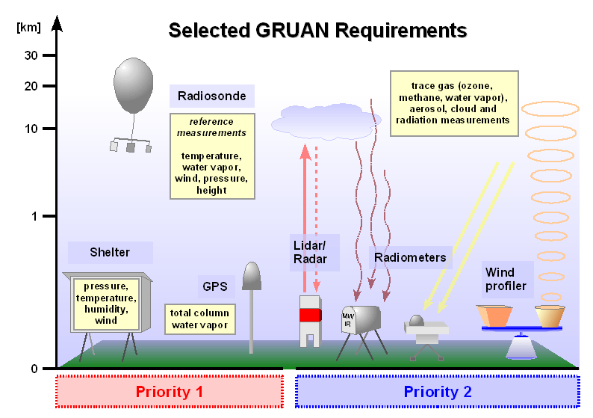
GRUAN goals
Maintain consistent observations over decades
Validation of satellite systems
Numerical weather prediction
Deliberate measurement redundancy
Standardization and traceability
Quality management and managed change
Priority 1:
temperature
water vapor
pressure and wind
Priority 2: Ozone, …
Notes:
GRUAN’s purpose is to provide reference observations for the following applications:
Climate records
NWP
Satellite validation

Slide 14
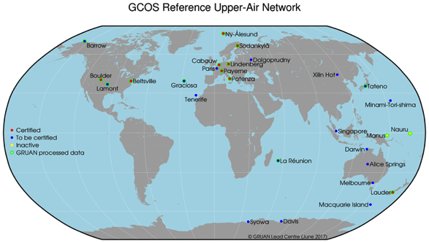
GRUAN sites
Notes:
Very pleased that very recently sites in Australia, Singapore and Russia joined the network. This helped to fill the void in the southern hemisphere. We are still looking for sites in Africa and southern America

Slide 15
GRUAN achievements
GRUAN data product for Vaisala RS92 radiosonde
Other radiosonde products are developed (Modem M10, Meisei RS11-G & iMS-100, Meteolabor SRS C34/C50, RS41, Frost point hygrometer)
Other products & data streams:
  GNSS total water vapor column
  Lidar (T, U)
  μ-wave radiometer (T, U)
Archive with ~30,000 GRUAN-processed radiosounding profiles
> 35 GRUAN-related publications
GRUAN data widely applied

Slide 16
Problems
Need for GRUAN sites in Africa, S. America, central Asia
Impending ban on R23 cryogen
Vacant co-chair
Limited resources at Lead Centre
  Embedded in In-situ sounding group
  Divide time between DWD and GRUAN matters
  Many tasks/action items reside with LC
  Delays/backlog
Potentially more support from GCOS Sec in the future

