Slide 1





The Global Observing System for Climate
GCOS
A workshop on
Terrestrial Climate Observations and human livelihoods
21 March 2018
GCOS Secretariat, WMO
Carolin Richter, Director

Slide 2
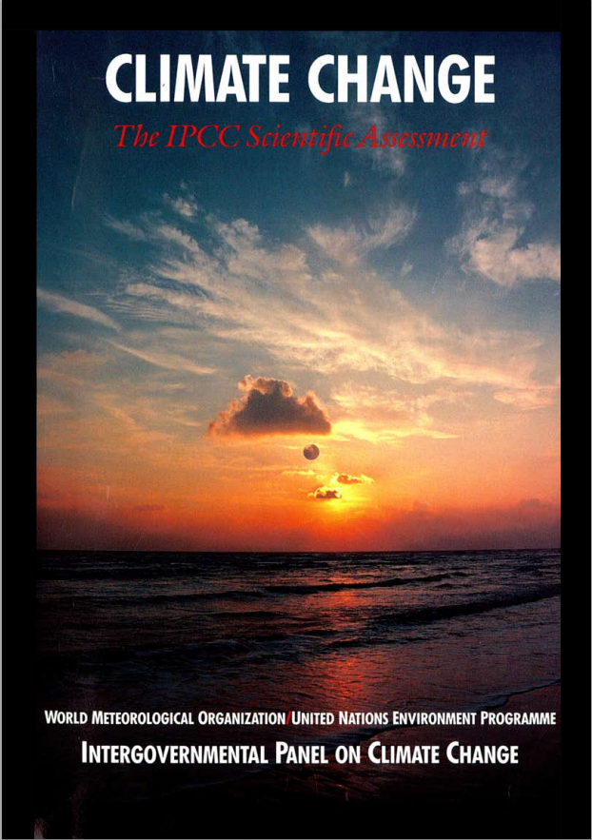
IPCC First Assessment Report 1990
IPCC First Assessment Report (1990)
IPCC concluded „that improved predictability of (human induced) climate change would require improved systematic observation of climate related variables on a global basis“

Slide 3
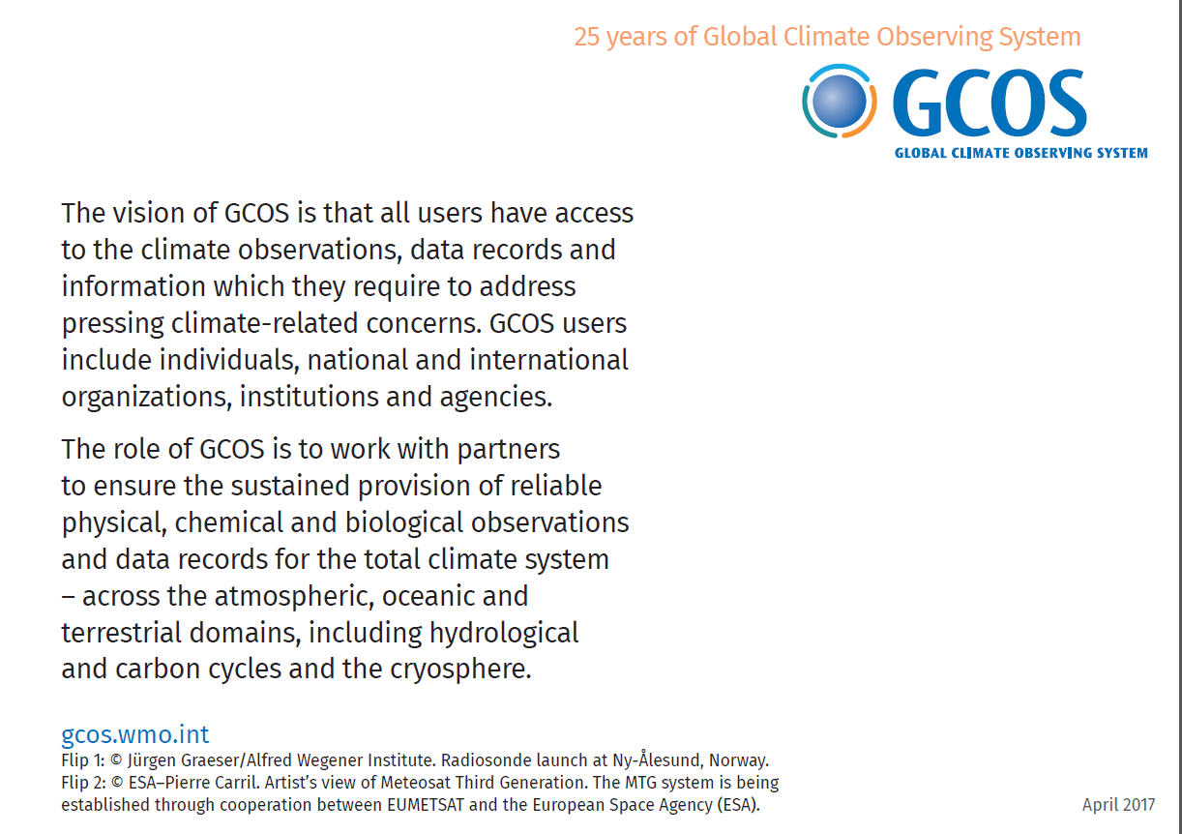





GCOS established April 1992

Slide 4
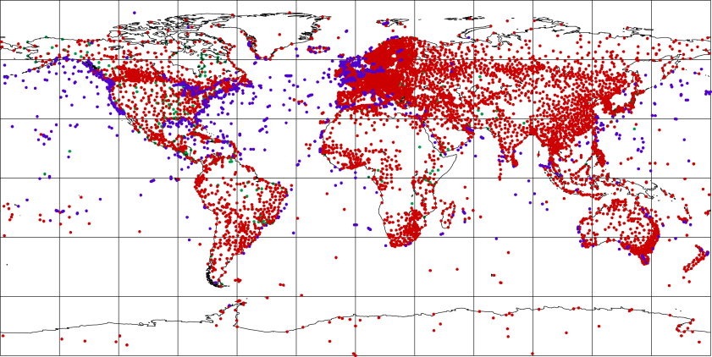

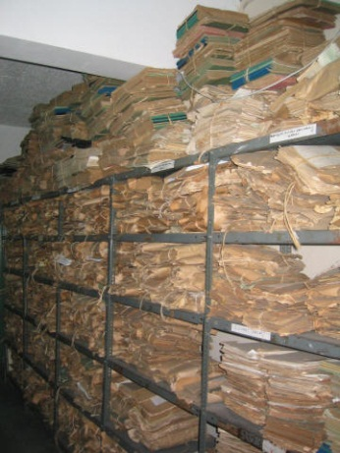
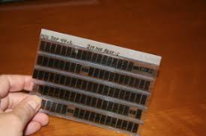

  GCOS is concerned with
  the observations
    what is measured, how it is measured,
    where it is measured, how measurement is sustained,
    how change is managed
  data transmission
    what is transmitted, with what time delay, in what code
  data management, including data rescue
    archiving and access to raw data, metadata, processed data records and products
    recovery and rehabilitation of past data
  data records and products
    fundamental records, including recalibration and homogenisation
    satellite retrievals, gridded fields from in situ and remotely-sensed measurements, comprehensive reanalyses of multiple observational datasets based on weather-prediction systems
Locations of 36064 surface weather observations received by ECMWF
09-15UTC 12 June 2012

Slide 5
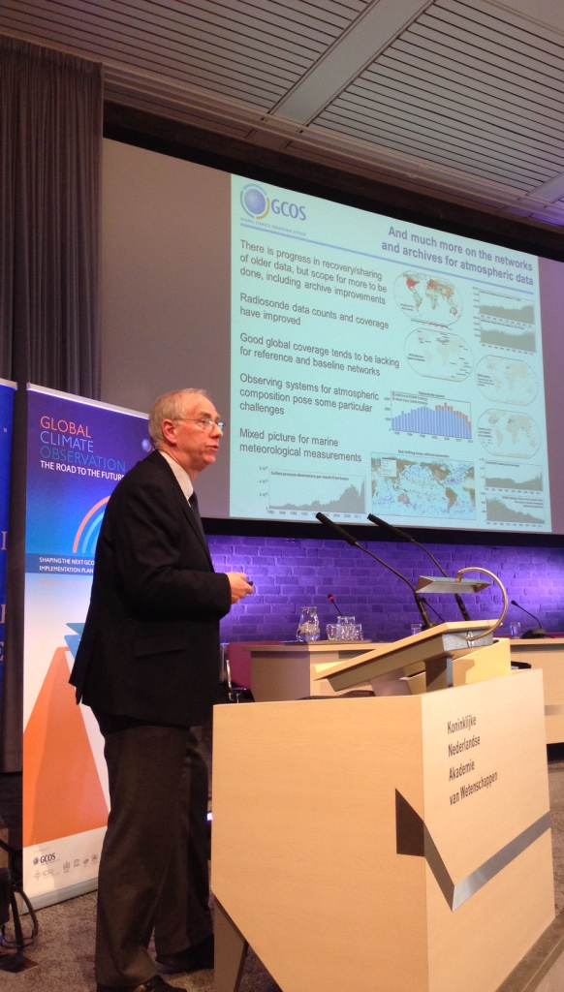
Some continuing concerns, including
  deterioration of some in situ networks; lack of progress in filling gaps in others
  limited provision for limb sounding and reference measurement from space
  but many improvements (that need sustaining) including
  quantity and quality of data from several in situ sources, including radiosondes
  quantity, quality and variety of data from satellites
  recovery and reprocessing of past data, both in situ and remotely sensed
  reanalysis, with coupling of atmosphere to ocean and land, and inclusion of chemistry
  conventional analysis of instrumental records
  converging temperature information from various observational and model datasets
  and evolving requirements
  e.g. for global, ground-based, soil-moisture data to complement remote sensing and reanalysis
Status Report, 2015
Source:Status Report 2015, A. Simmons

Slide 6



















TOPC has to watch over 19/54 ECVs
Notes:
In Paris last year, the SBSTA asked us to come back to Marrakesh, to submit a new implementation plan which will also take the Paris Agreement into account and that is what we have done. You will find the plan to download from the UNFCCC site, or from the GCOS web site.

Slide 7
HYDROLOGICAL ECVS
RIVER DISCHARGE
GROUNDWATER
LAKES
EVAPORATION FROM LAND
SOIL MOISTURE

Slide 8
CRYOSPHERE ECVS
SNOW
GLACIERS
ICE SHEETS
PERMAFROST

Slide 9
BIOSPHERE ECVS
LAI
ALBEDO
FAPAR
LAND-SURFACE TEMPERATURE
LAND COVER

Slide 10
BIOSPHERE ECVS
ABOVE-GROUND BIOMASS
SOIL CARBON
FIRE

Slide 11
HUMAN DIMENSION ECVS
ANTHROPOGENIC WATER USE
ANTHROPOGENIC GHG FLUXES

Slide 12
ECV SOIL MOISTURE – PRODUCTS – PHYSICAL QUANTITIES
Volumetric Soil Moisture – m3/m3
Freeze / Thaw - %
Surface Inundation - %
Root-zone soil moisture – m3/m3

Slide 13
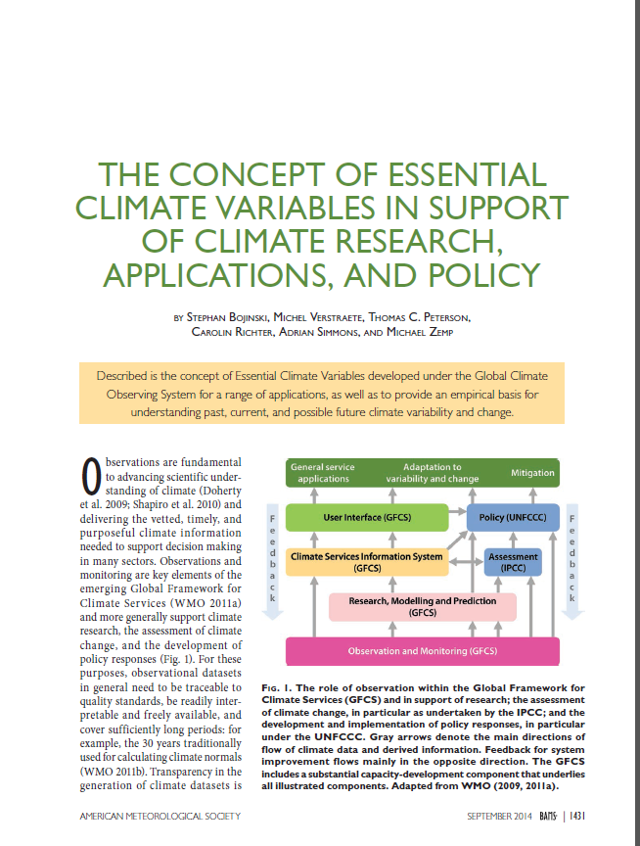
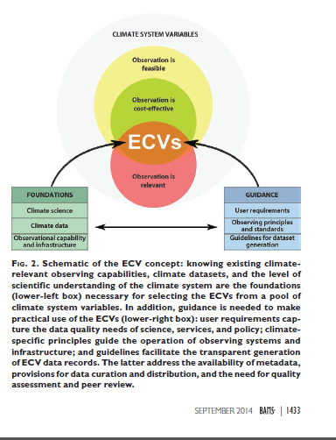
Concept of ECVs published– 2014
https://doi.org/10.1175/BAMS-D-13-00047.1
Published Online: 30 October 2014

Slide 14
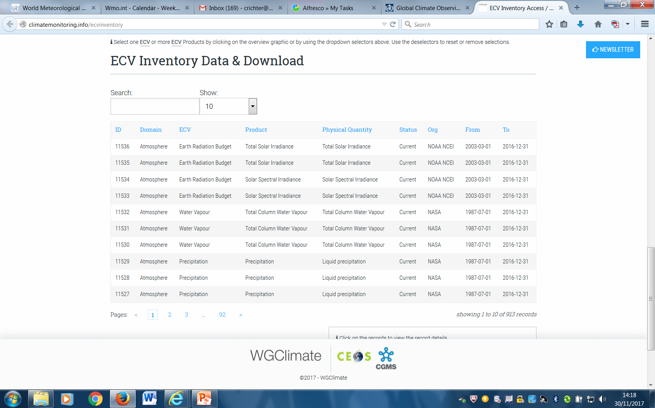
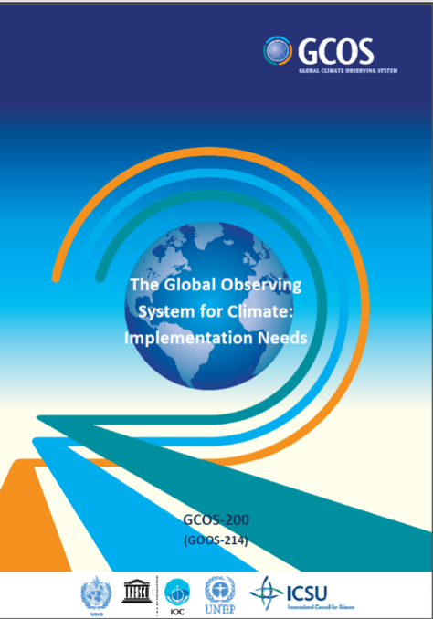
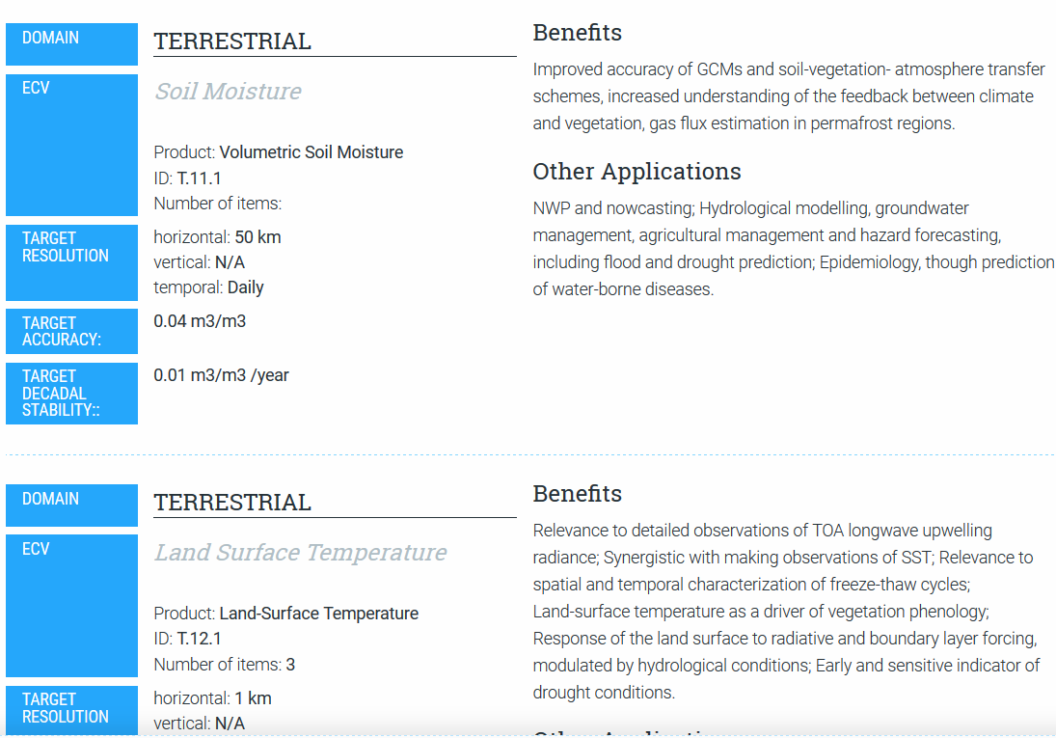

http://climatemonitoring.info/ecvinventory
30 ECVs / 37 available from satellites

Slide 15
Global Climate Indicators
Notes:
Present the information derived from the observations in a form that is relevant to the purposes of the diverse range of decision-makers and users addressing issues such as vulnerability and adaptation assessments, monitoring and evaluation, risk assessment and mitigation, development of early warning systems, adaptation and development planning and climate-proofing strategies within and across sectors.

Slide 16
Adapting to a changing climate – what observations are needed ?
  “Virtually all observations support adaptation.”
  “We must model what we cannot measure (or predict with global systems).”
  Adrian Simmons, Workshop on Observations for Adaptation, DWD, Offenbach, Feb 2013
Presentation: “The Global Climate Observing System: Observations and products from global to local”
Notes:
Virtually all observations support adaptation
this workshop is expected to focus on local or regional needs for observations,
products and related socio-economic data
requirements for local information - on past, present and future - have to be mapped
into needs for observations and products that may not be local
better observation will be required in general
to support better forecasting, to compensate for increased vulnerability to
severe weather and short-term climatic events
to support better projection of what we shall have to adapt to in the longer term
We must model what we cannot measure (or predict with global systems)
we require sustained systematic observation in principle
in practice we must fill gaps and downscale as best we can – or admit if we cannot
higher resolution (global or regional) reanalysis, regional modelling and
statistical downscaling are techniques available to us
should we develop a strategy that involves coherent sets of limited-term local
or regional observational projects that support the above?

Slide 17

GCOS/WCRP
Terrestrial Observation Panel
for Climate (TOPC)
gcos.wmo.int
@gcos_un
Notes:
In Paris last year, the SBSTA asked us to come back to Marrakesh, to submit a new implementation plan which will also take the Paris Agreement into account and that is what we have done. You will find the plan to download from the UNFCCC site, or from the GCOS web site.

